Slide 1
COURSE TITLE: Advanced Database Management Systems
UNIT -1

Slide 2
UNIT 1: Overview Of Databases and Data Modelling

Slide 3
Database & Database users and basics of SQL
What is Data?
Data is a collection of a distinct small unit of information. It can be used in a variety of forms like text, numbers, media, bytes, etc. it can be stored in pieces of paper or electronic memory, etc.
Word 'Data' is originated from the word 'datum' that means 'single piece of information.' It is plural of the word datum.

Slide 4
Database & Database users and basics of SQL
What is Database?
A database is an organized collection of data, so that it can be easily accessed and managed.
You can organize data into tables, rows, columns, and index it to make it easier to find relevant information.
The main purpose of the database is to operate a large amount of information by storing, retrieving, and managing data.

Slide 5

Database & Database users and basics of SQL
What is Database?
There are many dynamic websites on the World Wide Web nowadays which are handled through databases. For example, a model that checks the availability of rooms in a hotel. It is an example of a dynamic website that uses a database.
There are many databases available like MySQL, Sybase, Oracle, MongoDB, Informix, PostgreSQL, SQL Server, etc.
A cylindrical structure is used to display the image of a database.

Slide 6
Database & Database users and basics of SQL
What is Database?
Modern databases are managed by the database management system (DBMS).
SQL or Structured Query Language is used to operate on the data stored in a database. SQL depends on relational algebra and tuple relational calculus.
Application: Company Information, Account information, manufacturing, banking, finance transactions, telecommunications.

Slide 7
Database & Database users and basics of SQL
What is Database?
Modern databases are managed by the database management system (DBMS).
SQL or Structured Query Language is used to operate on the data stored in a database. SQL depends on relational algebra and tuple relational calculus.

Slide 8
Database & Database users and basics of SQL
What is Database users?
Database users interact with data to update, read and modify the given information on a daily basis. There are various types of database users and we will learn in detail about them.

Slide 9
Database & Database users and basics of SQL
What is Database users?
Database users can be divided into the following types −
End Users
Naive users / Parametric users
Sophisticated users
Application Programmer or Specialized users or Back-End Developer
System Analyst
Database Administrator (DBA)
Temporary Users or Casual Users

Slide 10
Database & Database users and basics of SQL
Database Administrator (DBA) :
Database Administrator (DBA) is a person/team who defines the schema and also controls the database.
The DBA will then create a new account id and password for the user if he/she need to access the database.
DBA is also responsible for providing security to the database and he allows only the authorized users to access/modify the data base. DBA is responsible for the problems such as security breaches and poor system response time.

Slide 11
Database & Database users and basics of SQL
Database Administrator (DBA) :
DBA also monitors the recovery and backup and provide technical support.
The DBA has a DBA account in the DBMS which called a system or superuser account.
DBA repairs damage caused due to hardware and/or software failures.

Slide 12
Database & Database users and basics of SQL
2. End Users/Parametric Users − These users access the database from the front end with the help of a pre-developed application. They have little knowledge about the design and working of databases.
There are two types of end users −
Naive Users − These naive users are those users who don’t have any database knowledge. They depend on pre-developed applications like Bank Management Systems, Library Management Systems, Hospital Management Systems, and Railway Ticket Booking Systems(IRCTC) and get the desired result.

Slide 13
Database & Database users and basics of SQL
There are two types of end users −
Sophisticated Users − Sophisticated users can be engineers, scientists, business analyst, who are familiar with the database. They can develop their own database applications according to their requirement. They don’t write the program code but they interact the database by writing SQL queries directly through the query processor.

Slide 14
Database & Database users and basics of SQL
3. Database Designers :
Data Base Designers are the users who design the structure of database which includes tables, indexes, views, triggers, stored procedures and constraints which are usually enforced before the database is created or populated with data.
4. Specialized users :
Specialized users are sophisticated users who write specialized database application that does not fit into the traditional data-processing framework. Among these applications are computer aided-design systems, knowledge-base and expert systems etc.

Slide 15
Database & Database users and basics of SQL
5. Application Programmers :
Application Programmers also referred as System Analysts or simply Software Engineers, are the back-end programmers who writes the code for the application programs. They are the computer professionals.
These programs could be written in Programming languages such as Visual Basic, Developer, C, FORTRAN, COBOL etc.
Application programmers design, debug, test, and maintain set of programs called “canned transactions” for the Naive (parametric) users in order to interact with database.

Slide 16
Database & Database users and basics of SQL
6. System Analyst :
System Analyst is a user who analyzes the requirements of parametric end users. They check whether all the requirements of end users are satisfied.
7. Casual Users / Temporary Users :
Casual Users are the users who occasionally use/access the database but each time when they access the database they require the new information, for example, Middle or higher level manager.

Slide 17
Database & Database users and basics of SQL
What is SQL?
SQL (Structured Query Language) is a language to operate databases; it includes Database Creation, Database Deletion, Fetching Data Rows, Modifying & Deleting Data rows, etc.
SQL stands for Structured Query Language. It is used for storing and managing data in relational database management system (RDMS).
It is a standard language for Relational Database System. It enables a user to create, read, update and delete relational databases and tables.
SQL allows users to query the database in a number of ways, using English-like statements.

Slide 18
Database & Database users and basics of SQL
What is SQL?
SQL is case insensitive. But it is a recommended practice to use keywords (like SELECT, UPDATE, CREATE, etc.) in capital letters and use user-defined things (like table name, column name, etc.) in small letters.

Slide 19
Database & Database users and basics of SQL
What is SQL?
Rules:
SQL follows the following rules:
Structure query language is not case sensitive. Generally, keywords of SQL are written in uppercase.
Statements of SQL are dependent on text lines. We can use a single SQL statement on one or multiple text line.
Using the SQL statements, you can perform most of the actions in a database.
SQL depends on tuple relational calculus and relational algebra.

Slide 20
Characteristics and advantages of the database
Characteristics:
Structured Data: Databases organize information into structured formats, making it easier to query and analyze.
Querying: They offer query languages (SQL, NoSQL queries, etc.) to retrieve specific data efficiently.
Scalability: Depending on the type (relational, NoSQL), databases can scale vertically (adding more resources to a single machine) or horizontally (adding more machines).

Slide 21
Characteristics and advantages of the database
Characteristics:
Security: They provide mechanisms for access control, authentication, and encryption to secure sensitive data.
Concurrency Control: Managing multiple users accessing the data simultaneously while ensuring consistency.
Backup and Recovery: Databases offer solutions for regular backups and recovery in case of data loss or corruption.

Slide 22
Characteristics and advantages of the database
Advantages:
Better Data Security: DBMS ensures privacy and security, vital for corporations investing in data protection against increased risks with more users.
Minimized Data Inconsistency: Properly designed databases significantly reduce inconsistencies, preventing conflicting versions of the same data.
Faster Data Access: Enables swift and accurate data retrieval, aiding faster decision-making processes and facilitating queries for specific information.

Slide 23
Characteristics and advantages of the database
Advantages:
Enhanced Decision Making: DBMS provides better-managed data, improved access, and quality, enabling informed decisions based on data insights.
Reduced Data Redundancy: Prevents duplicate entries in structured databases, ensuring efficiency by eliminating repeated information.
Atomicity and Data Consistency: Ensures that changes in one part of the database reflect across the entire system, maintaining data consistency and accuracy.

Slide 24
ACID Properties in DBMS
A transaction is a single logical unit of work that accesses and possibly modifies the contents of a database. Transactions access data using read and write operations.
In order to maintain consistency in a database, before and after the transaction, certain properties are followed. These are called ACID properties.

Slide 25
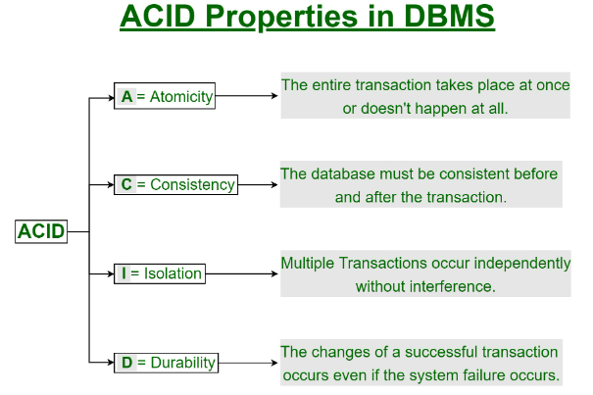
ACID Properties in DBMS

Slide 26
ACID Properties in DBMS
Atomicity: Ensures transactions are all-or-nothing, either fully completed or not at all, maintaining data integrity.
Consistency: Guarantees that transactions preserve the database's rules and constraints, keeping data accurate and valid.
Isolation: Allows multiple transactions to run simultaneously without interfering with each other, preventing conflicts and maintaining transaction integrity.
Durability: Confirms that once a transaction is committed, its changes are permanently saved and survive system failures, ensuring data persistence.

Slide 27
Database systems, concepts and architecture
Concepts:
Data Model: Defines how data is structured and organized within the database (e.g., relational, hierarchical, network, or object-oriented models).
Schema: Represents the logical layout and structure of the database, including tables, relationships, and constraints.
Normalization: Process of organizing data to minimize redundancy and dependency, ensuring data integrity.

Slide 28
Database systems, concepts and architecture
Concepts:
4. Querying and Languages: Tools like SQL (Structured Query Language) or NoSQL queries enable users to retrieve, manipulate, and manage data.
5. Transactions: Units of work performed on the database that follow ACID properties (Atomicity, Consistency, Isolation, Durability) to maintain data integrity.

Slide 29
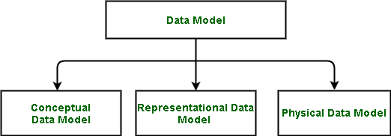
Data Models in DBMS
A Data Model in Database Management System (DBMS) is the concept of tools that are developed to summarize the description of the database.
Types of Relational Models
Conceptual Data Model
Representational Data Model
Physical Data Model

Slide 30
Data Models in DBMS
Conceptual Data Model
The conceptual data model describes the database at a very high level and is useful to understand the needs or requirements of the database. It is this model, that is used in the requirement-gathering process i.e. before the Database Designers start making a particular database.
One such popular model is the entity/relationship model (ER model). The E/R model specializes in entities, relationships, and even attributes that are used by database designers.

Slide 31
Data Models in DBMS
Entity-Relationship Model( ER Model): It is a high-level data model which is used to define the data and the relationships between them. It is basically a conceptual design of any database which is easy to design the view of data.
Components of ER Model:
Entity: An entity is referred to as a real-world object. It can be a name, place, object, class, etc. These are represented by a rectangle in an ER Diagram.
Attributes: An attribute can be defined as the description of the entity. These are represented by Eclipse in an ER Diagram. It can be Age, Roll Number, or Marks for a Student.
Relationship: Relationships are used to define relations among different entities. Diamonds and Rhombus are used to show Relationships.

Slide 32
Data Models in DBMS
2. Representational Data Model
This type of data model is used to represent only the logical part of the database and does not represent the physical structure of the database.
The representational data model allows us to focus primarily, on the design part of the database. A popular representational model is a Relational model.
The relational Model consists of Relational Algebra and Relational Calculus. In the Relational Model, we basically use tables to represent our data and the relationships between them. It is a theoretical concept whose practical implementation is done in Physical Data Model.

Slide 33
Data Models in DBMS
3. Physical Data Model
The physical Data Model is used to practically implement Relational Data Model. Ultimately, all data in a database is stored physically on a secondary storage device such as discs and tapes.
This is stored in the form of files, records, and certain other data structures.
In order to come up with a good physical model, we have to work on the relational model in a better way.
Structured Query Language (SQL) is used to practically implement Relational Algebra.

Slide 34
Schemas & instances
Instances
An Instance is the state of an operational database with data at any given time. It contains a snapshot of the database. The instances can be changed by certain operations, such as like addition, and deletion of data. It may be noted that any search query will not make any kind of changes in the instances.
Example:
Let’s say a table ‘teacher’ in our database whose name is School, suppose the table has 50 records so the instance of the database has 50 records for now and tomorrow we are going to add another fifty records so tomorrow the instance has a total of 100 records. This is called an instance.

Slide 35
Schemas & instances
Schema
Schema is the overall description of the database. The basic structure of how the data will be stored in the database is called schema.
Schema is of three types: Logical Schema, Physical Schema and view Schema.
Logical Schema – It describes the database designed at a logical level. At this level, the programmer and data administrator perform their work.
Physical Schema – It describes the database designed at the physical level.
View Schema – It defines the design of the database at the view level.

Slide 36
Schemas & instances
Schema
Example:
Let’s say a table teacher in our database named school, the teacher table requires the name, dob, and doj in their table so we design a structure as:
Teacher table
name: String
doj: date
dob: date
Above given is the schema of the table teacher.

Slide 37
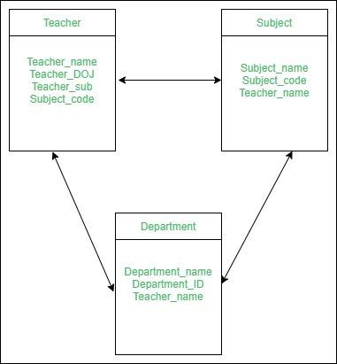
Schemas & instances
Schema

Slide 38
Codd’s rules
Codd’s rules are proposed by a computer scientist named Dr. Edgar F. Codd and he also invent the relational model for database management.
These rules are made to ensure data integrity, consistency, and usability. This set of rules basically signifies the characteristics and requirements of a relational database management system (RDBMS).

Slide 39
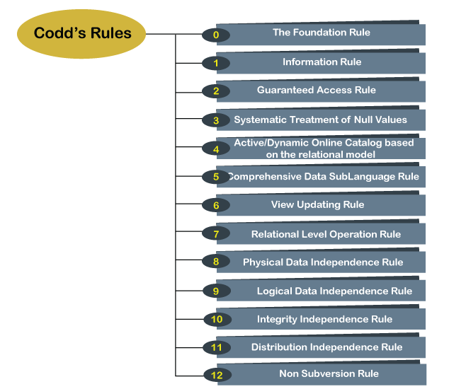
Codd’s rules

Slide 40
Codd’s rules
Codd’s Rules in DBMS
Rule 1: The Information Rule
All information, whether it is user information or metadata, that is stored in a database must be entered as a value in a cell of a table. It is said that everything within the database is organized in a table layout.
Rule 2: The Guaranteed Access Rule
Each data element is guaranteed to be accessible logically with a combination of the table name, primary key (row value), and attribute name (column value).
Rule 3: Systematic Treatment of NULL Values
Every Null value in a database must be given a systematic and uniform treatment.

Slide 41
Codd’s rules
Rule 4: Active Online Catalog Rule
The database catalog, which contains metadata about the database, must be stored and accessed using the same relational database management system.
Rule 5: The Comprehensive Data Sublanguage Rule
A crucial component of any efficient database system is its ability to offer an easily understandable data manipulation language (DML) that facilitates defining, querying, and modifying information within the database.
Rule 6: The View Updating Rule
All views that are theoretically updatable must also be updatable by the system.

Slide 42
Codd’s rules
Rule 7: High-level Insert, Update, and Delete
A successful database system must possess the feature of facilitating high-level insertions, updates, and deletions that can grant users the ability to conduct these operations with ease through a single query.
Rule 8: Physical Data Independence
Application programs and activities should remain unaffected when changes are made to the physical storage structures or methods.
Rule 9: Logical Data Independence
Application programs and activities should remain unaffected when changes are made to the logical structure of the data, such as adding or modifying tables.

Slide 43
Three-Schema architecture & data independence
The three-schema architecture divides the database into three-level used to create a separation between the physical database and the user application. In simple terms, this architecture hides the details of physical storage from the user.
This architecture contains three layers of database management system, which are as follows −
External level
Conceptual level
Internal level

Slide 44
Three-Schema architecture & data independence
1. User View (External Level):
What it is: This is how the database appears to individual users or applications.
In simple terms: It's like the customized view of the database that each person or application sees.
Example: A sales team may have a user view showing only customer names and order details.
1. Logical View (Conceptual Level):
What it is: It represents the overall logical structure of the entire database.
In simple terms: It's like the big picture of how different pieces of information relate to each other.
Example: Showing how customers, orders, and products are connected in the database.

Slide 45
Three-Schema architecture & data independence
3. Physical View (Internal Level):
What it is: Describes how data is physically stored on the computer's storage media.
In simple terms: It's like understanding where and how the data is stored on the computer, like files and indexes.
Example: Knowing that customer names are stored in a specific file on the hard drive.

Slide 46
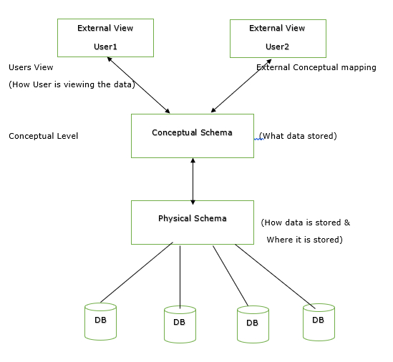
Three-Schema architecture & data independence

Slide 47
Data independence
Data independence in Database Management Systems (DBMS) refers to the ability to modify the database structure (schema) without affecting the application programs that interact with the data. There are two types of data independence:
Logical Data Independence:
What it is: Ability to change the logical structure (organization, relationships) of the data without changing how users or applications interact with the data.
In simple terms: You can alter how data is organized without breaking the programs using that data.
Example: Adding a new table or changing the relationship between existing tables without affecting queries or applications.

Slide 48
Data independence
Physical Data Independence:
What it is: Ability to change the physical storage and representation of data without affecting the logical structure or the way users access the data.
In simple terms: You can change how data is stored (on disk, in memory) without impacting how users perceive or query the data.
Example: Switching from one storage system to another without requiring changes to applications using the data.

Slide 49
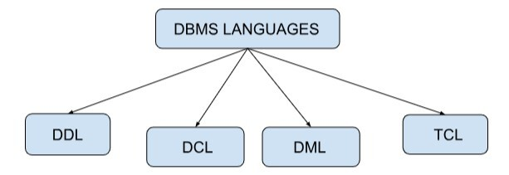
Database Languages
Database Languages
Database languages are used to read, store and update the data in the database. Specific languages are used to perform various operations of the database.

Slide 50
Database Languages
DDL(Data Definition Language)
Data Definition Language(DDL) is used for describing structures or patterns and its relationship in a database. It is also used to define the database schema, tables, index, Constraints, etc.
The commands used in DDL are:
Create: It is used to create a database or table.
Alter: It is used to make a change in the structure of a database.
Drop: It is used to completely delete a table from the database
Rename: It is used to rename a table.
Truncate: It is used to delete the entities inside the table while holding the structure of the table.
Comment: It is used to comment on the data dictionary.

Slide 51
Database Languages
DML(Data Manipulation Language)
DML is used to manipulate the data present in the table or database. We can easily perform operations such as store, modify, update, and delete on the database.
The commands used in DML are:
Select: It shows the record of the specific table. Also, it can be used with a WHERE clause to get the particular record.
Insert: It allows users to insert data into the database or tables.
Update: It is used to update or modify the existing data in database tables.
Delete: It is used to delete records from the database tables. Also, it can be used with a WHERE clause to delete a particular row from the table.
Merge: It allows the insert and update(UPSERT) operations.

Slide 52
Database Languages
DCL(Data Control Language)
DCL works to deal with SQL commands that are used to permit a user to access, modify and work on a database. it is used to access stored data. It gives access, revokes access, and changes the permission to the owner of the database as per the requirement.
The commands used in DCL are:
Grant: It is used to give access to security privileges to a specific database user.
Revoke: It is used to revoke the access from the user that is being granted by the grant command.

Slide 53
Database Languages
TCL(Transaction Control Language)
It can be grouped into a logical transaction and is used to run the changes made by the DML command in the database.
Commit: Transaction on the database is saved using Commit.
Rollback: The database gets restored to the original since the last commit.

Slide 54
Interface
An interface is like a program that lets you talk to a database without having to write complicated code. It helps you do things like adding, deleting, updating, or looking at data in the database.
Types of Interface:
Form-based Interface: Fill in a form for database entries (e.g., a student entering roll number for a grade card).
Menu-based User Interface: Choose options from a menu to form requests (e.g., selecting categories on a shopping website).

Slide 55
Interface
Types of Interface:
3. GUI (Graphical User Interface): Use pictures and diagrams for queries (e.g., changing a 'like' color on Instagram).
4. Natural Language Interface: Talk to the database like talking to a person (e.g., googling "fastest car in India").
5. Speech Input and Output: Communicate with the interface through speech (e.g., using "OK Google" or Siri).

Slide 56
Centralized and Client/Server Architecture of DBMS
Centralized Architecture:
Explanation: All data and processing are on one big computer (central server). Users directly interact with this server.
Pros: Simple setup, easy control, and coordination.
Cons: Can be slow when many users are accessing the server simultaneously. If the central server fails, the whole system is affected.

Slide 57
Centralized and Client/Server Architecture of DBMS
Client/Server Architecture:
Explanation: Data is on a central server, but users interact with it through smaller computers (clients). Clients request data or services from the server.
Pros: Efficient, scalable, and allows distributed access. If one client fails, it doesn't affect others.
Cons: More complex to set up, and maintaining security across clients can be challenging.

Slide 58
Centralized and Client/Server Architecture of DBMS
Analogy:
Centralized (Library): Imagine a library where all books are in one place. People go there to read or borrow books, and if the library has a problem, everyone is affected.
Client/Server (Restaurant): Picture a restaurant with a central kitchen (server) preparing food. Each table (client) can order separately. If one table has an issue, others can still enjoy their meals.

Slide 59
Centralized and Client-Server DBMS Architectures
Centralized DBMS:
Combines everything into single system including- DBMS software, hardware, application programs, and user interface processing software.
User can still connect through a remote terminal – however, all processing is done at centralized site.

Slide 60
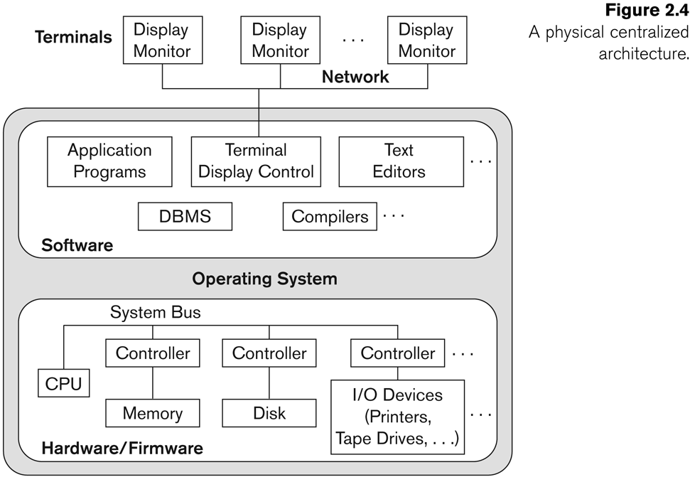
A Physical Centralized Architecture

Slide 61
Basic 2-tier Client-Server Architectures
Specialized Servers with Specialized functions
Print server
File server
DBMS server
Web server
Email server
Clients can access the specialized servers as needed

Slide 62
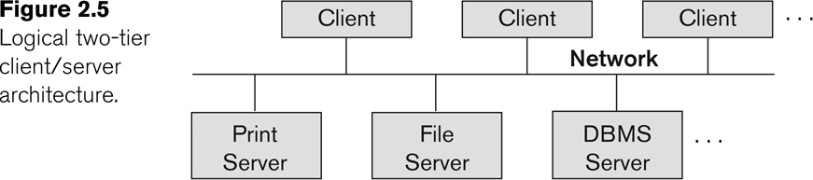
Logical two-tier client server architecture

Slide 63
Clients
Provide appropriate interfaces through a client software module to access and utilize the various server resources.
Clients may be diskless machines or PCs or Workstations with disks with only the client software installed.
Connected to the servers via some form of a network.
(LAN: local area network, wireless network, etc.)

Slide 64
DBMS Server
Provides database query and transaction services to the clients
Relational DBMS servers are often called SQL servers, query servers, or transaction servers
Applications running on clients utilize an Application Program Interface (API) to access server databases via standard interface such as:
ODBC: Open Database Connectivity standard
JDBC: for Java programming access
Client and server must install appropriate client module and server module software for ODBC or JDBC
See Chapter 9

Slide 65
Two Tier Client-Server Architecture
A client program may connect to several DBMSs, sometimes called the data sources.
In general, data sources can be files or other non-DBMS software that manages data.
Other variations of clients are possible: e.g., in some object DBMSs, more functionality is transferred to clients including data dictionary functions, optimization and recovery across multiple servers, etc.

Slide 66
Three Tier Client-Server Architecture
Common for Web applications
Intermediate Layer called Application Server or Web Server:
Stores the web connectivity software and the business logic part of the application used to access the corresponding data from the database server
Acts like a conduit for sending partially processed data between the database server and the client.
Three-tier Architecture Can Enhance Security:
Database server only accessible via middle tier
Clients cannot directly access database server

Slide 67
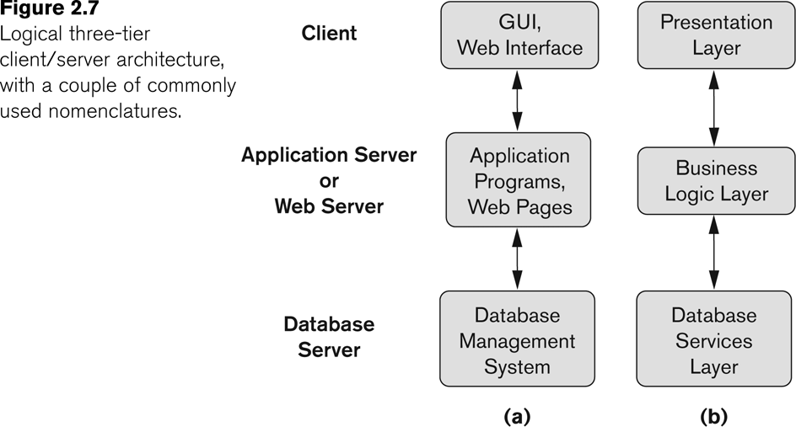
Three-tier client-server architecture

Slide 68
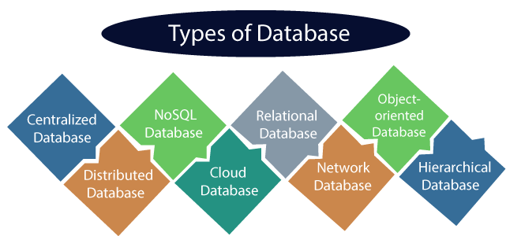
Classification of DBMS
Types of DBMS:
1. Relational Database:
Description: Organizes data in tables using rows and columns.
Key Feature: Uses SQL; each table has a unique key field.
Examples: Oracle, MySQL, Microsoft SQL Server.
Std ID Name City
201 Bob Hyderabad
204 LMN Chennai
ABC Bangalore

Slide 69
Classification of DBMS
Types of DBMS:
2. Object Oriented Database:
Description: Represents data as objects, combining relational and object-oriented concepts.
Key Feature: Incorporates OOP principles like inheritance and encapsulation.
Example: Object DB software.
3. Hierarchical Database:
Description: Organizes data in a tree-like structure with a one-to-many relationship.
Example: IMS (IBM), Windows registry (Microsoft).

Slide 70
Classification of DBMS
Types of DBMS:
4. Network Database:
Description: Maintains one-to-one or many-to-many relationships, organized like a graph.
Key Feature: Allows multiple parents for one child record.
Example: Teachers teaching in multiple departments.
Each type serves specific needs, and the choice depends on factors like data relationships, complexity, and application requirements.

Slide 71
ER Diagrams
The Entity Relationship Diagram explains the relationship among the entities present in the database.
ER models are used to model real-world objects like a person, a car, or a company and the relation between these real-world objects.
In short, the ER Diagram is the structural format of the database.

Slide 72
ER Diagrams
Why Use ER Diagrams In DBMS?
ER diagrams are used to represent the E-R model in a database, which makes them easy to be converted into relations (tables).
ER diagrams provide the purpose of real-world modeling of objects which makes them intently useful.
ER diagrams require no technical knowledge and no hardware support.
These diagrams are very easy to understand and easy to create even for a naive user.
It gives a standard solution for visualizing the data logically.

Slide 73
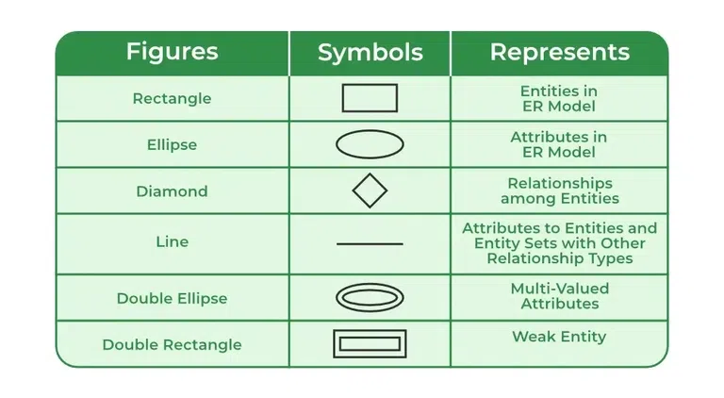
ER Diagrams
Symbols Used in ER Model

Slide 74
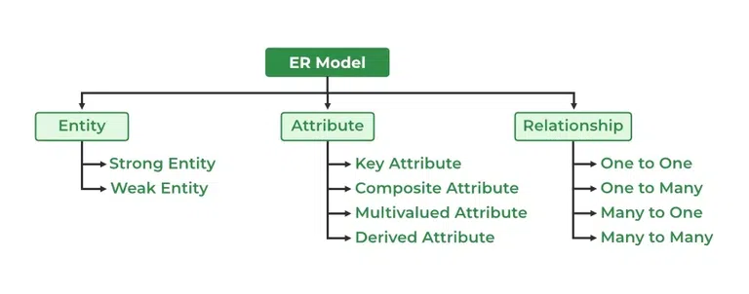
ER Diagrams
Components of ER Diagram
ER Model consists of Entities, Attributes, and Relationships among Entities in a Database System.

Slide 75


ER Diagrams
1. Entity:
An entity may be any object, class, person or place. In the ER diagram, an entity can be represented as rectangles.
a. Weak Entity
An entity that depends on another entity called a weak entity. The weak entity doesn't contain any key attribute of its own. The weak entity is represented by a double rectangle.

Slide 76
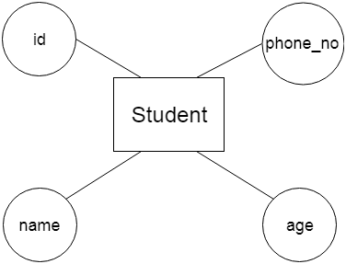
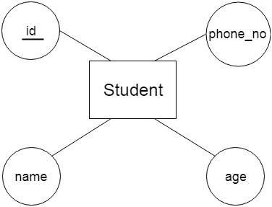
ER Diagrams
2. Attribute
The attribute is used to describe the property of an entity. Eclipse is used to represent an attribute.
For example, id, age, contact number, name, etc. can be attributes of a student.
a. Key Attribute
The key attribute is used to represent the main characteristics of an entity. It represents a primary key. The key attribute is represented by an ellipse with the text underlined.

Slide 77
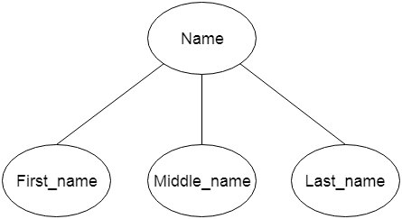
ER Diagrams
b. Composite Attribute
An attribute that composed of many other attributes is known as a composite attribute. The composite attribute is represented by an ellipse, and those ellipses are connected with an ellipse.

Slide 78
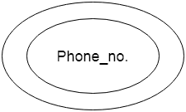
ER Diagrams
c. Multivalued Attribute
An attribute can have more than one value. These attributes are known as a multivalued attribute. The double oval is used to represent multivalued attribute.
For example, a student can have more than one phone number.

Slide 79
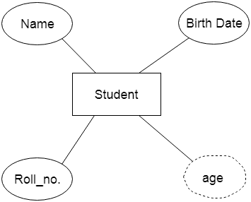
ER Diagrams
d. Derived Attribute
An attribute that can be derived from other attribute is known as a derived attribute. It can be represented by a dashed ellipse.
For example, A person's age changes over time and can be derived from another attribute like Date of birth.

Slide 80




ER Diagrams
3. Relationship
A relationship is used to describe the relation between entities. Diamond or rhombus is used to represent the relationship.
Types of relationship are as follows:

Slide 81
Refining the COMPANY database schema by introducing relationships
By examining the requirements, six relationship types are identified
Listed below with their participating entity types:
WORKS_FOR (between EMPLOYEE, DEPARTMENT)
MANAGES (also between EMPLOYEE, DEPARTMENT)
CONTROLS (between DEPARTMENT, PROJECT)
WORKS_ON (between EMPLOYEE, PROJECT)
SUPERVISION (between EMPLOYEE (as subordinate), EMPLOYEE (as supervisor))
DEPENDENTS_OF (between EMPLOYEE, DEPENDENT)

Slide 82
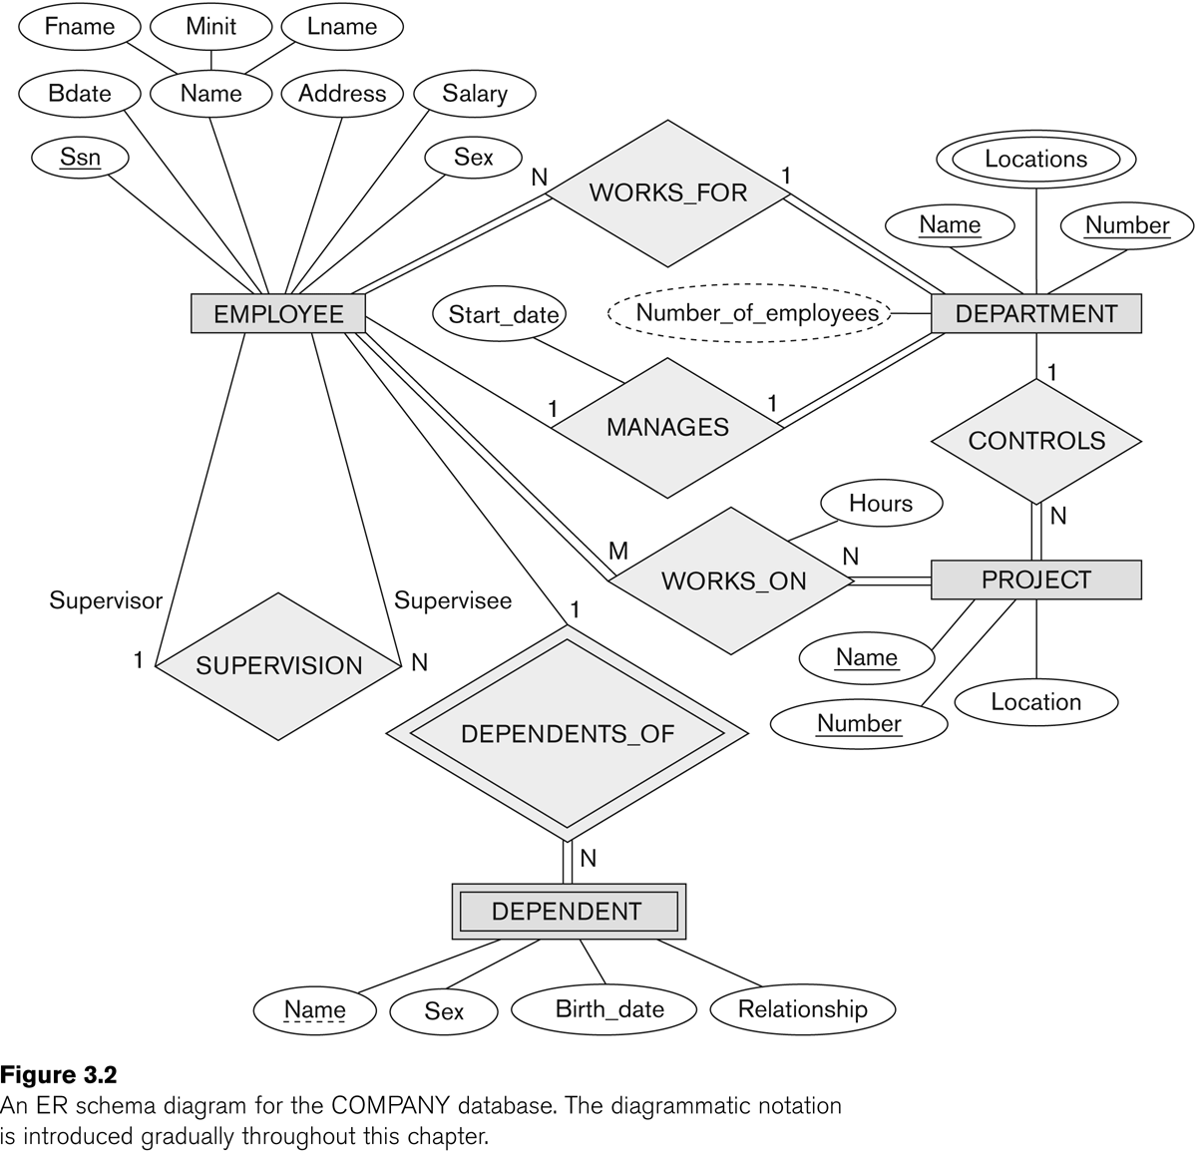
Refining the COMPANY database schema by introducing relationships

Slide 83
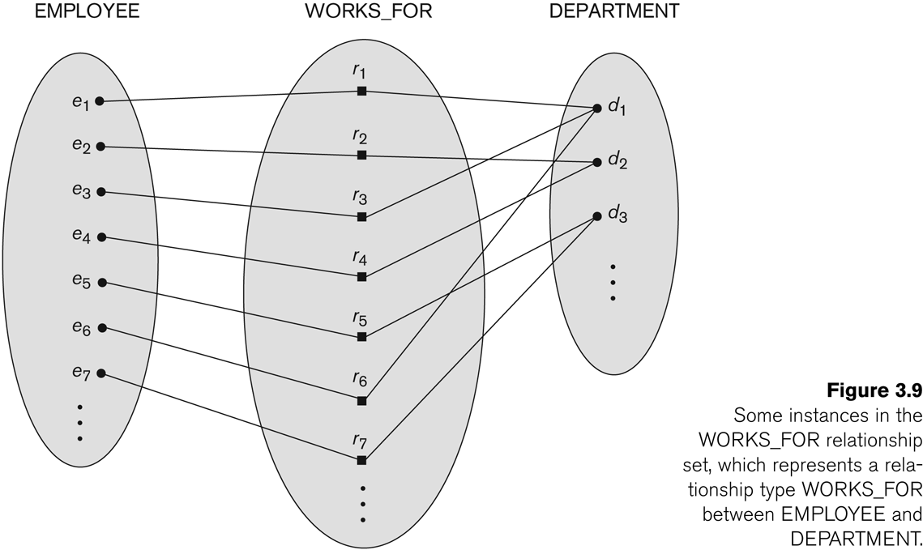
Many-to-one (N:1) Relationship

Slide 84
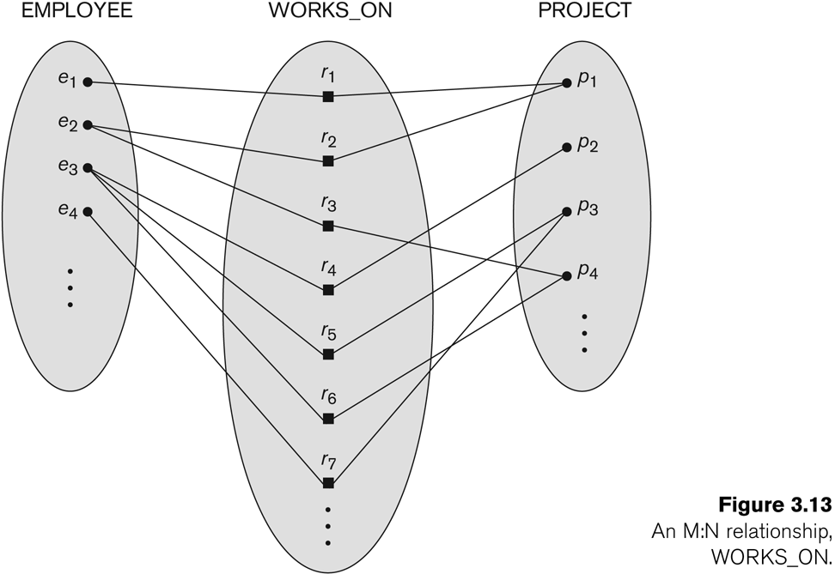
Many-to-many (M:N) Relationship

Slide 85
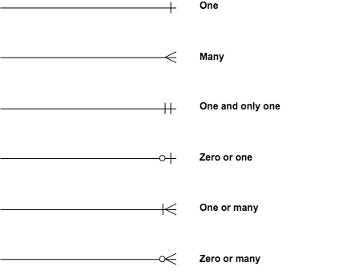
Many-to-many (M:N) Relationship

Slide 86
Examples of E-R model
Hospital ER Model
This is an ER model of a Hospital. The entities are represented in rectangular boxes and are Patient, Tests and Doctor.
Each of these entities have their respective attributes which are −
Patients - ID(primary key), name, age,visit_date
Tests- Name(primary key), date, result
Doctor- ID(primary key), name, specialization
The relationships between different entities are represented by a diamond shaped box.

Slide 87
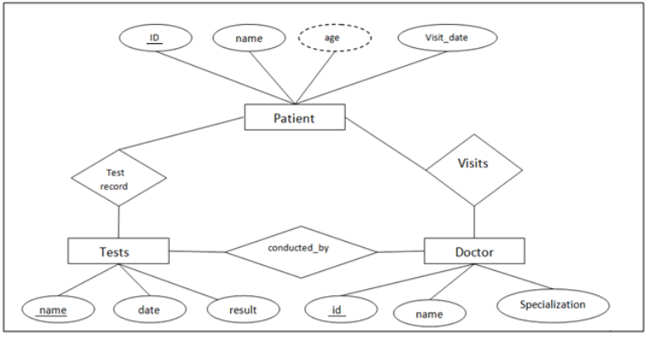
Examples of E-R model
Hospital ER Model

Slide 88
Examples of E-R model
Company ER Model
The entities in this ER model are Employee, Department and Project. These entities have the following attributes −
Employee - ENO(Primary Key) , Name, Salary
Department - DNO(Primary key), Name, Locations
Project - PNO(Primary key), Name
The relationships in this ER model are represented as Works for and Controls.

Slide 89
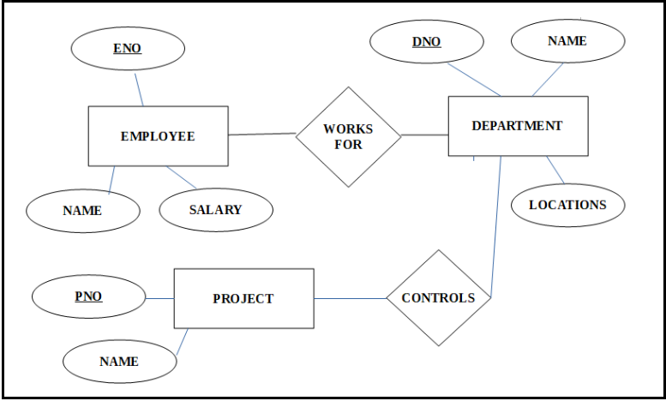
Examples of E-R model
Company ER Model

Slide 90
Examples of E-R model
Practice questions for ER Diagram
1. University System:
Scenario: Design a database for a university system. Consider entities like students, professors, courses, departments, and classes. Include relationships such as enrollment, teaching, and department affiliation.
Online Bookstore: Make an ER diagram for this problem.
2. Online Bookstore:
Scenario: Create an ER diagram for an online bookstore. Include entities like books, authors, customers, orders, and publishers. Define relationships like purchasing, authorship, and publishing. Make an ER diagram for this problem.

Slide 91
Extended Entity-Relationship (EE-R) Model
EER is a high-level data model that incorporates the extensions to the original ER model. Enhanced ERD are high level models that represent the requirements and complexities of complex database.
In addition to ER model concepts EE-R includes −
Subclasses and Super classes.
Specialization and Generalization.
Category or union type.
Aggregation.

Slide 92
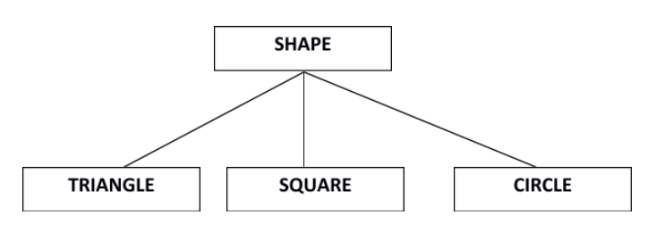
Extended Entity-Relationship (EE-R) Model
Subclasses and Super class
Super class is an entity that can be divided into further subtype.
For example − consider Shape super class.
Super class shape has sub groups: Triangle, Square and Circle.
Sub classes are the group of entities with some unique attributes. Sub class inherits the properties and attributes from super class.

Slide 93
Extended Entity-Relationship (EE-R) Model
Specialization and Generalization
Generalization is a process of generalizing an entity which contains generalized attributes or properties of generalized entities.
It is a Bottom up process i.e. consider we have 3 sub entities Car, Truck and Motorcycle. Now these three entities can be generalized into one super class named as Vehicle.
Specialization is a process of identifying subsets of an entity that share some different characteristic. It is a top down approach in which one entity is broken down into low level entity.
In above example Vehicle entity can be a Car, Truck or Motorcycle.

Slide 94
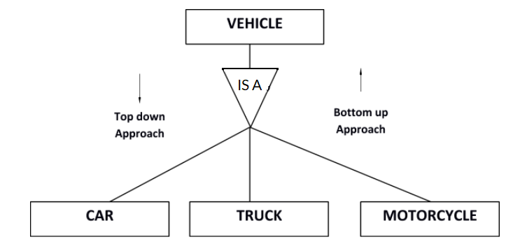
Extended Entity-Relationship (EE-R) Model
Specialization and Generalization

Slide 95
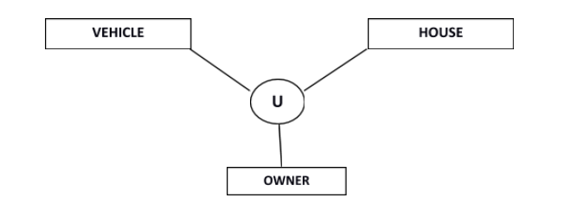
Extended Entity-Relationship (EE-R) Model
Category or Union
Relationship of one super or sub class with more than one super class.
Owner is the subset of two super class: Vehicle and House.

Slide 96
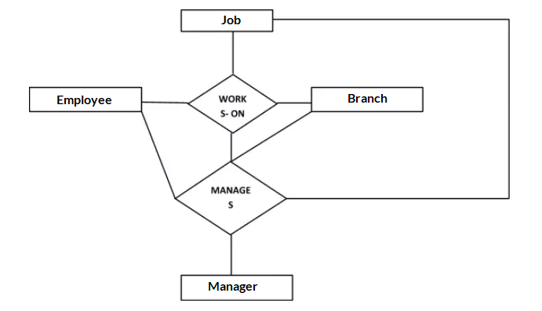
Extended Entity-Relationship (EE-R) Model
Aggregation
Represents relationship between a whole object and its component.
Consider a ternary relationship Works_On between Employee, Branch and Manager. Now the best way to model this situation is to use aggregation, So, the relationship-set, Works_On is a higher level entity-set.

Slide 97
Extended Entity-Relationship (EE-R) Model
When to use ER diagrams vs. EER diagrams
An ER diagram gives you the visual outlook of your database. It details the relationships and attributes of its entities, paving the way for smooth database development in the steps ahead.
EER diagrams, on the other hand, are perfect for taking a more detailed look at your information. When your database contains a larger amount of data, it’s best to turn to an enhanced version to more deeply understand your model.
So, when should you use which? Honestly, both are useful, and it mostly depends on the size and detail of your data. The more complicated the data, the more likely you’ll need to use an EER diagram to make sure you’re properly organizing every relationship.

Slide 98
Extended Entity-Relationship (EE-R) Model
Mark the cardinalities and participation
If all members in the superclass(main entity) participate in either one subclass it is known as total participation. It marks by double lines.
If at least one member in the superclass does not participate in subclass it is known as partial participation. It is denoted by one single line.
If all the members in the superclass participate for only one subclass it is known as disjoint and denoted by “d”. If all the members in the superclass participate in more than one subclass it is known as overlap and denoted by “o”.

Slide 99
Extended Entity-Relationship (EE-R) Model
Example:
This example instance of “sub-class” relationships. Here we have four sets of employees: Secretary, Technician, and Engineer. The employee is a super-class of the rest three sets of individual sub-class is a subset of Employee set.

Slide 100
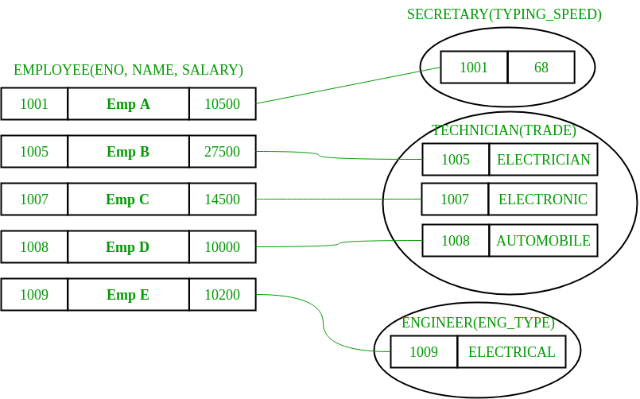
Extended Entity-Relationship (EE-R) Model

Slide 101
Extended Entity-Relationship (EE-R) Model
An entity belonging to a sub-class is related to some super-class entity. For instance emp, no 1001 is a secretary, and his typing speed is 68. Emp no 1009 is an engineer (sub-class) and her trade is “Electrical”, so forth.
Sub-class entity “inherits” all attributes of super-class; for example, employee 1001 will have attributes eno, name, salary, and typing speed.

Slide 102
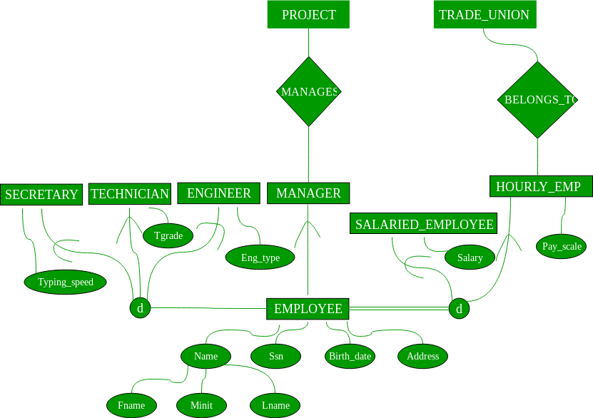
Extended Entity-Relationship (EE-R) Model

Slide 103
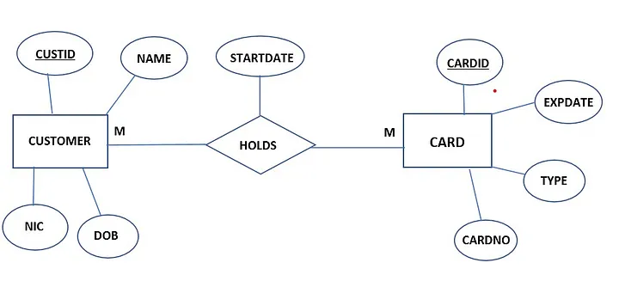
Extended Entity-Relationship (EE-R) Model

Slide 104
Extended Entity-Relationship (EE-R) Model
If it is many to many relations you should always make a new relationship with the name of the relationship between the entities.
And there you should write both primary keys of the entities and attributes in the relationship and map them to the initials as shown below.

Slide 105
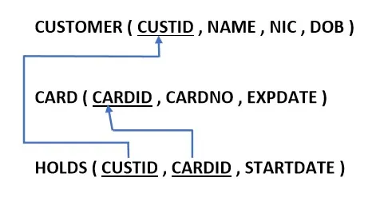
Extended Entity-Relationship (EE-R) Model

Slide 106
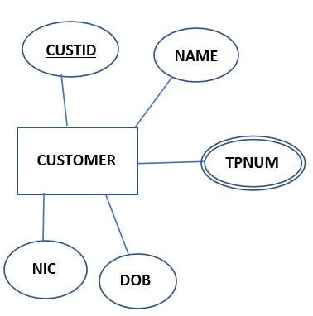
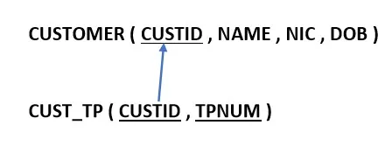
Extended Entity-Relationship (EE-R) Model
If there are multivalued attributes you have to make a new relationship with a suitable name and write the primary key of the entity which belongs to the multivalued attribute and also the name of the multivalued attribute as shown below.

